Slide 1
Docker Containers
The Basics

Slide 2
What are we going to do today?
Go over some basic theory
Understand Docker Use cases
Build a Docker base image
Push the Docker Base image to Docker Hub
Build a LAMP stack using Dockerfile and out base image
Test
Push to Docker Hub
Get some homework

Slide 3
What is Docker?
Docker is an open-source platform that allows you to automate the deployment, scaling, and management of applications using containerization.
It provides a way to package applications and their dependencies into standardized units called containers.
Containers are lightweight, isolated, and portable environments that encapsulate all the necessary components for an application to run, including the code, runtime, system tools, libraries, and settings.
Docker enables you to create, distribute, and run containers consistently across different environments, such as development, testing, and production.
Docker uses a client-server architecture, where the Docker client interacts with the Docker daemon, which in turn manages the containers and their execution.
The Docker client allows you to build, run, and manage containers using simple commands, while the Docker daemon takes care of managing the container lifecycle, resource allocation, and networking.
One of the key advantages of Docker is its ability to provide consistent and reproducible environments. By encapsulating applications and their dependencies within containers, you can ensure that they run consistently regardless of the underlying infrastructure.
This makes it easier to develop, test, and deploy applications across different environments, reducing the likelihood of "it works on my machine" issues.
Docker also promotes scalability and resource efficiency.
Containers are lightweight and share the host system's kernel, allowing multiple containers to run on the same machine without duplicating the underlying operating system.
This enables efficient utilization of system resources and makes it easy to scale applications up or down based on demand.
Overall, Docker simplifies the process of managing and deploying applications, improves consistency across different environments, and enables efficient utilization of resources, making it a popular choice for containerization and application deployment.

Slide 4
Why Docker and not a VM?
Lightweight: Docker containers are much lighter compared to traditional VMs. Containers share the host system's operating system kernel, which eliminates the need to run a separate guest operating system for each container. This results in faster startup times, reduced resource overhead, and improved efficiency.
Performance: Since Docker containers do not require the overhead of running a full operating system, they can achieve better performance compared to VMs. Containers have direct access to the host system's resources, resulting in lower latency and better utilization of system resources.
Portability: Docker containers provide a consistent and portable environment. Containers package applications along with their dependencies, configurations, and libraries, making them highly portable across different systems and environments. Containers can run on any host system that has the necessary container runtime, enabling easy deployment and migration across different infrastructure setups.
Scalability: Docker enables easy scaling of applications. Containers can be quickly replicated and deployed across multiple hosts or orchestrated using container orchestration platforms like Docker Swarm or Kubernetes. This makes it simpler to scale applications up or down based on demand, allowing for better resource allocation and improved application availability.
Isolation: Docker containers offer process-level isolation, ensuring that applications running within containers are isolated from each other and the host system. This isolation provides an additional layer of security and helps prevent conflicts between different applications or dependencies.
DevOps-friendly: Docker and containerization align well with modern DevOps practices. Containers facilitate the packaging of applications and their dependencies, making it easier to create reproducible build artifacts. Containers also enable consistent deployment across different environments, from development to production, reducing the chances of environment-related issues and simplifying the continuous integration and continuous deployment (CI/CD) pipeline.

Slide 5
Anatomy of a Docker Container
Container
Volumes
Network
Application
Application
Application
Application
Base Image

Slide 6
What are Containers?
Containers are lightweight, standalone executable units of software that include everything needed to run an application, including the code, runtime, system tools, libraries, and settings.
They provide a consistent and reproducible environment, isolating the application from the underlying system and other applications.

Slide 7
Why use Containers?
Containers offer several benefits, including:
Portability: Containers can run on any system that supports the container runtime, making it easy to deploy applications across different environments.
Scalability: Containers can be quickly scaled up or down based on demand, allowing applications to handle varying workloads efficiently.
Isolation: Containers provide process-level isolation, ensuring that applications run in their own isolated environments without interfering with each other.
Efficiency: Containers are lightweight and share the host system's kernel, enabling efficient resource utilization and reducing overhead.

Slide 8
Immutable Images
Immutable images refer to the concept of treating containers as immutable artifacts.
Once an image is built, it remains unchanged throughout its lifecycle.
Instead of making updates or modifications to a running container, a new image is created with the necessary changes.

Slide 9
Base Images
A base image is the starting point for building a Docker image.
It contains the essential components needed to run an application, such as the operating system, runtime, and necessary dependencies.
Base images can be official images provided by Docker or custom images created by users.

Slide 10
Creating a base image
To create a base image, you can start with an existing base image, such as an official Ubuntu or Alpine image, and customize it by installing additional packages, setting up configurations, or adding application-specific dependencies.

Slide 11
Dockerfile
FROM
This is going to use the official ubuntu core base image, it’s a minimal core image
RUN
Once the core image is spun up, this command will be run
Don’t
RUN apt get update
RUN apt get install –y nano nmap net-tools
CMD
This is something which runs in the background and keeps the container running
# Use a base image
FROM ubuntu:latest
# Install necessary packages
RUN apt-get update && apt-get install -y nano nmap net-tools
# Set the default command
CMD ["tail", "-f", "/dev/null"]

Slide 12
Build it
sudo
Run docker commands as sudo
Docker build
-t is a tag, name of the image
The . Is the local directory
What's going to happen?
Docker is going to parse the Dockerfile
The ubuntu:latest image will be pulled down from Docker Hub
The Ubuntu image wil be run
The Apt commands will be executed
This will be wrapped as a new image called my-docker-image
docker build -t my-docker-image .

Slide 13
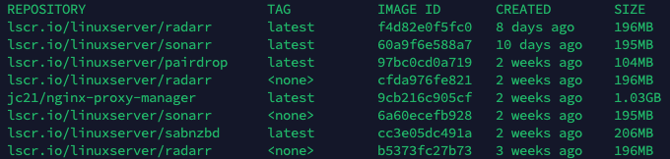
Docker Commands
Docker format
docker <thing> <command>
docker image ls
docker image inspect
docker container ls
docker network ls
How is the image made up?
Inspect and history will provide a great detail of information of how an image is made up, the sizes of each layer
docker image ls
docker image inspect <image id>
docker image history <image id>

Slide 14

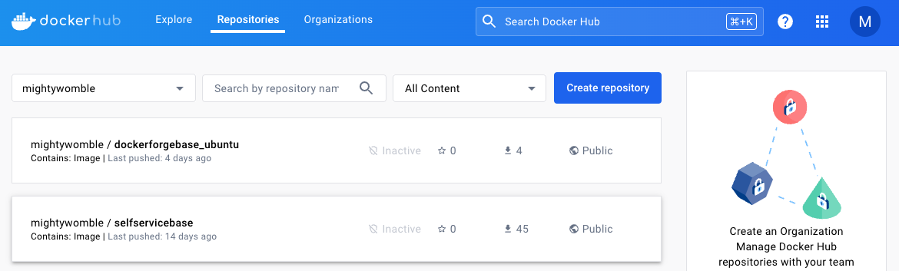
Docker Hub
What is Docker Hub?
Docker Hub is a repository to store Docker images.
It’s the Default repository Docker looks at
Do I need to use Docker Hub?
No, you could use Artifact, Azure , AWS, Proget there are lots of repo choices
Is there a cost?
For DockerHub, at this level, no.
Go to: https://hub.docker.com/
Click on Sign Up

Slide 15
Docker Login
Why Login?
This is the login to the Docker repository from your docker command
By default this login is to docker hub
It can be to any 3rd party repository
As well
Credential Storage
Its possible to store your credentials in config.json we won't cover that on this course.
docker login
docker login <servername>:<port>

Slide 16
Docker Tag
What is a tag?
A tag is essentially a label assigned to a Docker image to help identify it. It typically consists of two components:
Image name (also known as repository name): This is the name of the image.
Tag: This is an optional identifier, commonly used to represent a specific version or variant of the image. If no tag is specified,
Docker automatically assigns the latest tag to the image by default
Why tag?
Version Control
Traceability
Automation
Troubleshooting
Reading:
https://kodekloud.com/blog/docker-image-tag/
docker tag my-docker-image:latest <docker hub username>/<repo name>
docker tag my-docker-image:latest davidfield/mybaseimage
Docker image ls
Docker build –t my-docker-image .

Slide 17
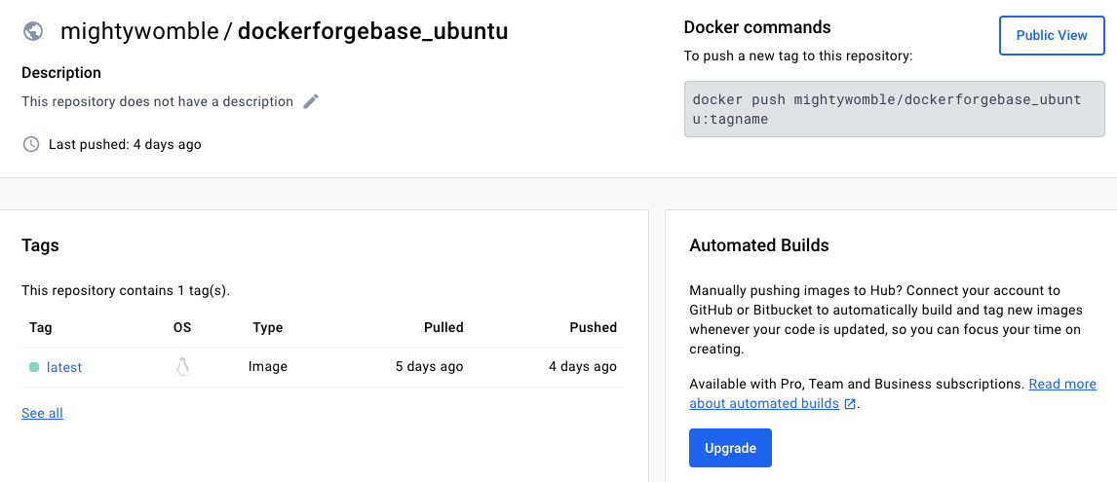
Docker Push
From your PC to your Repo
Docker push is taking the image on your local repo and pushing it to your remote repos
Similar to git push
Check your http://hub.docker.com repo
docker push my-docker-image:latest <docker hub username>/<repo name>
docker push my-docker-image:latest davidfield/mybaseimage

Slide 18
What have we done so far?
Understood a little bit about docker.
Created a Dockerfile
Built a base image
Tagged our Docker image
Created a Docker Hub Account
Pushed an image up to Docker Hub

Slide 19
What Next?
Use our Base image
Create an application layer on the top of it
Install a LAMP Stack
Open up some Ports (EXPOSE)
Open up some volumes (VOLUME)
Rebuild our image
Use it to create a container and Test it
Push it to Docker Hub

Slide 20
Dockerfile
Dockerfile is slightly more complex
Lets break it down
FROM davidfield/mybaseimage:latest
# Install Apache2 and PHP
RUN apt-get update && \
DEBIAN_FRONTEND=noninteractive apt-get install -y apache2 php
# Configure Apache2
RUN a2enmod rewrite && \
sed -i 's/DocumentRoot \/var\/www\/html/DocumentRoot \/var\/www\/html/g' /etc/apache2/sites-available/000-default.conf
# Expose ports 80 and 443
EXPOSE 80 443
# Mount volumes for /etc/apache2/sites-enabled, /etc/apache2/sites-available, and /var/www/html
VOLUME ["/etc/apache2/sites-enabled", "/etc/apache2/sites-available", "/var/www/html"]
# Start Apache2 service
CMD service apache2 start && tail -f /dev/null

Slide 21
Dockerfile - FROM
FROM
This time we use the base image we pushed to Docker hub
RUN
Stringing multiple commands on one line keeping our image laters lowered and saving space on the image size.
Installing updates
Installing apache2 and php
FROM davidfield/mybaseimage:latest
# Install Apache2 and PHP
RUN apt-get update && \
DEBIAN_FRONTEND=noninteractive apt-get install -y apache2 php

Slide 22
Dockerfile - RUN
RUN
The Run Syntax allows us to run any command line we would normally run on the OS in the container build
As an example the sed command is changing the Document Root in the 000-default.conf file
# Configure Apache2
RUN a2enmod rewrite && \
sed -i 's/DocumentRoot \/var\/www\/html/DocumentRoot \/var\/www\/html/g' /etc/apache2/sites-available/000-default.conf

Slide 23
Dockerfile - Expose
EXPOSE
If the application you want to run has ports which need exposing to reach it, thse can much like a firewall be exposed (open) from outside the Docker Container.
If we don't do this, then Apache will run, however outside the container we con't be able to view the webpage.
Other examples might be API ports, ssh ports, custom ports
# Expose ports 80 and 443
EXPOSE 80 443

Slide 24
Dockerfile - VOLUME
VOLUME
Volume like expose provides the outside world access to the filesystem within the container.
Remember, Docker Containers are immutable.
Each time they start, they do so with no data
If you added a whole set of files inside the container to /var/www/html when the container is running.
When the container restarts all the files would be gone
Immutable
# Mount volumes for /etc/apache2/sites-enabled, /etc/apache2/sites-available, and /var/www/html
VOLUME ["/etc/apache2/sites-enabled", "/etc/apache2/sites-available", "/var/www/html"]

Slide 25
Dockerfile - CMD
CMD
Whats the difference between RUN and CMD?
RUN is used to execute commands during the build process of a Docker image, while CMD is used to specify the default command to run when a Docker container is started from the image.
What is this doing?
When the resulting container starts
apache2 will start
tail –f /dev/null will run in the background
Why tail?
Once a Docker container has spun up, it will execute what it has been told to run, then shut down, running tail indefinatly in the background keeps the contrainer running.
# Start Apache2 service
CMD service apache2 start && tail -f /dev/null

Slide 26
Build it
sudo
Run docker commands as sudo
Docker build
-t is a tag, name of the image
The . Is the local directory
What's going to happen?
Docker is going to parse the Dockerfile
The ubuntu:latest image will be pulled down from Docker Hub
The Ubuntu image wil be run
The Apt commands will be executed
This will be wrapped as a new image called my-docker-image
docker build -t my-apache-server:1.0.0 .
docker image ls

Slide 27
Run it
docker run
This is how we turn the image we just created into a docker container.
Imagine you've installed Windows on a PC hard disk
This is the bit where we turn it on and run it
Lets break this command down
docker run –d -p 80:80 -p 443:443 -v /opt/docker/sites-enabled:/etc/apache2/sites-enabled -v /opt/docker/sites-available:/etc/apache2/sites-available -v /opt/docker/html:/var/www/html my-apache-server:1.0.0

Slide 28
Run it - Explained
Command | What's it doing?
-d | This runs the docker container detached from the command, without it, the container will run until you Ctrl-C and kill the docker command
-p 80:80 | This is mappping the TCP port on the computer to the TCP Port inside the container. Left Outside, Right inside I could use –p 8080:80 if my computer was already running something on port 80
-p 443:443 | Another port mapping
-v /opt/docker/sites-enabled:/etc/apache2/sites-enabled | This is a volume mapping, the same rule applies so Left Outside, Right inside When the container spins up /opt/docker/site-senabled will be available on my local PC, when I restart the container, the volume is remapped and I can still see my files. They are on my PC, not my container
-v /opt/docker/sites-available:/etc/apache2/sites-available | Another volume mapping
-v /opt/docker/html:/var/www/html | Another volume mapping
apache-server:1.0.0 | This is our image

Slide 29
Test it
Resources
Remember when we ran docker run, we mapped the port 80 in the container (right) to port 80 on the host PC (left) -p 80:80
This means the docker container is now using port 80 on my local host
Open in your browser
http://localhost

Slide 30
Docker container management

Slide 31
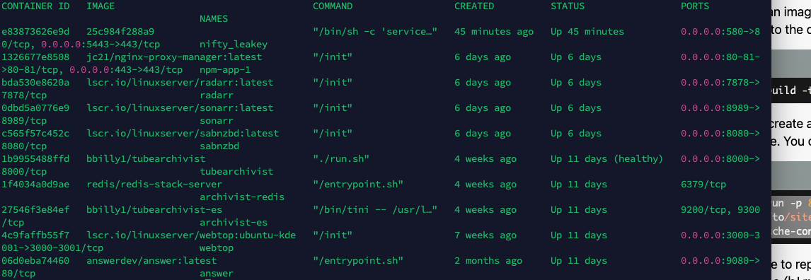
docker ps
Docker ps
The docker pc command is used to show details about containers
docker ps - shows running containers
docker ps –a – shows all created containers
docker container ls – shows all created containers
docker ps
docker ps -a
docker container ls

Slide 32
docker logs
Logs
Docker files are essentially mini OS and as such generate logs, logs are useful for pinpointing errors on startup or other issues.
Running docker logs on its own will show a snapshot of what is happening now.
Running docker logs –f will show a realtime log output (ctrl – c to stop)
docker logs <container ID>
docker logs –f <container id>

Slide 33
docker start stop rm
Logs
While docker run will create a new container with the flags you presented it.
Once a docker container has been created using docker run these commands are used to manage the docker container.
You cannot rm a running vm, it must be stopped.
Docker run command is used without the –name flag, it will create a container with a random name.
If you do use for example –name myserver during docker run and then run the same run command with the same –name again, the command will fail because the container name is already in use.
docker start <container id>
docker stop <container id>
docker rm <container id>

Slide 34
Let's add a file to our image
The Ask
Create a basic html file
Copy it into the image when we build it
Test it

Slide 35
COPY
COPY
In Docker, there are two ways to copy a file, namely, ADD and COPY.
Though there is a slight difference between them in regard to the scope of the functions, they more or less perform the same task. I
If you want to copy files and directories inside a Docker Container from your Local machine, you can use the COPY instruction inside your Dockerfile.
COPY <src-path> <destination-path>
If we have a file called example.html in the same folder as our Dockerfile
COPY example.html /var/www/html/

Slide 36
Build it again
docker built –t <name>:<tag> .
Things to consider
Name?
Tag?
Test?
Logs?

Slide 37
Test it
How can you troubleshoot?
docker logs
docker ps
netstat -plnt
Do the volumes exist?
http://localhost/<filename.html>
What happens if you edit the html file and restart the container?
Method 1
docker exec –it <container id>
Method 2
Directly edit the /opt/docker/html/<filename>

Slide 38
Docker Push
Have you version conroleed your tags?
How can you confirm the image is on Docker hub?
Did you run docker login?
docker push my-docker-image:latest <docker hub username>/<repo name>
docker push my-docker-image:latest davidfield/mybaseimage

Slide 39
What did we learn?
docker run
docker logs
docker start/stop/restart
docker rm
Updating a docker image
We can test locally
Immutable images
Copy local files using dockerfile copy

Slide 40
Homework
Create your own Github Repo
Save your work to it
There is a site https://roadmap.sh/docker
This could be run locally as a Docker container
Create an Image, post it to Docker Hub, make sure the instructions to run it are there
Let me know when I can try it.
https://github.com/kamranahmedse/developer-roadmap

